Slide 1
School Choice
Part 2
INFO 4220 – Networks II: Market Design
Adapted from Haeringer Ch.13 & 14

Slide 2
Recap – The School Choice Problem
School choice is a many-to-one assignment problem
We can evaluate assignment in terms of:
  Stability: Individually rational, non-wasteful, no justified envy
  Efficiency: You cannot find another assignment that makes at least 1 student better off without making anyone worse off
We would like to have efficiency and stability, but they are incompatible
  Stability can be obtained with DA (with students proposing). This is also strategyproof (for students)
  Efficiency can be obtained using TTC. Also strategyproof
Another popular algorithm is immediate acceptance. It produces an efficient matching. But it is not stable nor strategyproof

Slide 3
Recap – The School Choice Problem
The Boston Public School case
  BPC was using the immediate acceptance algorithm
  The system was started to be perceived as unfair
  Abdulkadiroğlu, Pathak, Roth and Sönmez were asked for recommendations to reform the BPS assignment system
  Two options were proposed: Deferred acceptance and top-trading cycles
  What should we care about: Stability or efficiency?
    In the medical match stability is an issue, as doctors (and/or hospitals) may choose not to participate in the market. The same shouldn’t happen in a school district. No other way to get into a school, schools cannot break apart from the system
    Efficiency seems like a desirable goal, but they chose D.A.

Slide 4
Recap – The School Choice Problem
NYC was having a congestion problem in their school assignment process
  About 30,000 students were not getting a school assigned each year and had to be dealt with manually
  The learnt about the medical match, and thought about adapting it
NYC switched from a decentralized to a centralized matching system
  School choice in NYC looks more like a matching problem: Some schools were behaving strategically because they had preferences over students
  DA with students proposing was chosen for the matching mechanism
  With DA they went from ~30,000 to ~3,000 unassigned students per year

Slide 5
Today: The Problem of Weak Priorities
Until now we have assumed that schools have strict priorities over students
This is not true, as we saw many prospective students have the same “right” to attend a specific school
We had to induce strict priorities by means of random draws:
  We were fine with doing this for other types of problems
  But for schools it seems wrong and unfair. Can we find a way to relax this assumption. Make this as fair as possible.

Slide 6
This lecture
Why weak priorities introduce inefficiencies
How to fix the inefficiencies introduced by weak priorities
Different methods for breaking ties in weak priorities
Constraining priority lists and its effects
Some practical/behavioral considerations

Slide 7
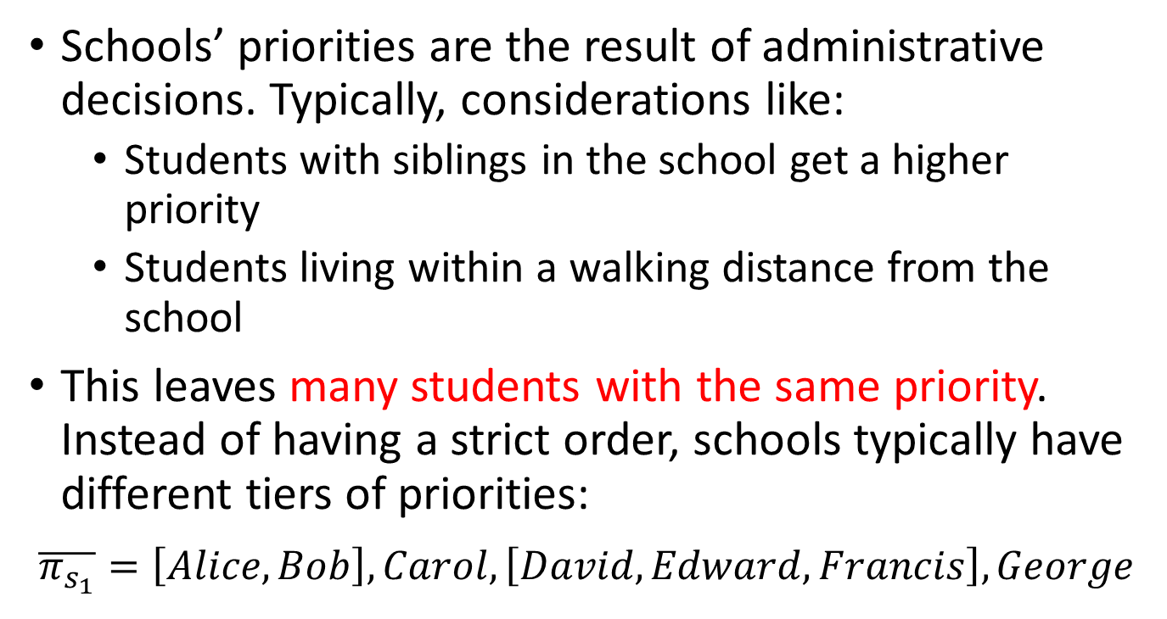
Schools’ Priorities
Schools’ priorities are the result of administrative decisions. Typically, considerations like:
  Students with siblings in the school get a higher priority
  Students living within a walking distance from the school
This leaves many students with the same priority. Instead of having a strict order, schools typically have different tiers of priorities:
$$\overline{π_{s_{1}}}=\left[Alice, Bob\right], Carol, \left[David, Edward, Francis\right], George$$
The bar means weak priorities

Slide 8
Weak Priorities and Algorithms
If we have weak priorities, we cannot use the algorithms we have seen (DA, IA or TTC)
Example: 2 students, Alice and Bob, have listed school 1 as their top choice. They both have the same priority (and highest among all applicants) at school 1. School 1 has only 1 seat available. What happens if we try to use DA with students proposing:
  Alice and Bob make a proposal to school 1
  School 1 must reject one of them. But which?
  You may flip a coin to choose… but this creates a series of problems

Slide 9
Efficiency Loss
When schools’ priorities were strict, the DA algorithm with students proposing gave us students’ most preferred stable assignments
But if we created strict preferences by breaking ties with lotteries this may no longer be the case
Important: You need to compare the assignment to the original priority list, not the list without ties
When we introduce lotteries to break ties, we introduce tradeoffs between efficiency, stability, and strategyproofness

Slide 10
Stability
When we break ties randomly, an assignment will not be stable if any of the following is true:
Not individually rational: A student is assigned to a school they find unacceptable
Wasteful: A student is not assigned to any school, and there is a school the find acceptable with seats available
There is justified envy: A student prefers a school to their assignment, and another student with a strictly lower priority is assigned to that school

Slide 11
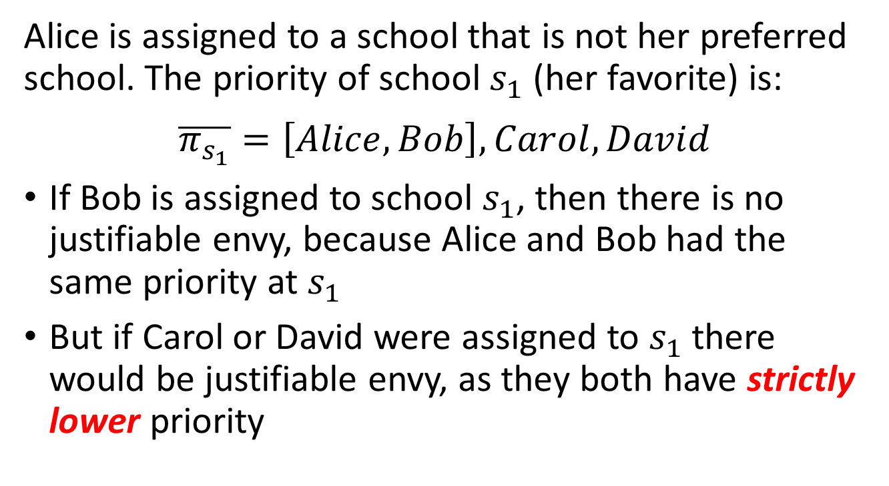
Example
Alice is assigned to a school that is not her preferred school. The priority of school $s_{1}$ (her favorite) is:
$$\overline{π_{s_{1}}}=\left[Alice, Bob\right], Carol, David$$
If Bob is assigned to school $s_{1}$, then there is no justifiable envy, because Alice and Bob had the same priority at $s_{1}$
But if Carol or David were assigned to $s_{1}$ there would be justifiable envy, as they both have strictly lower priority

Slide 12
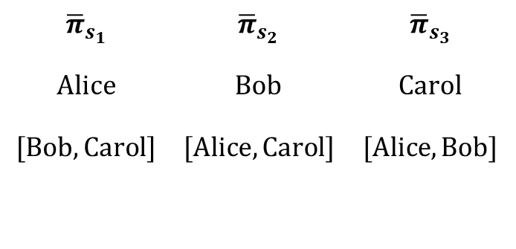
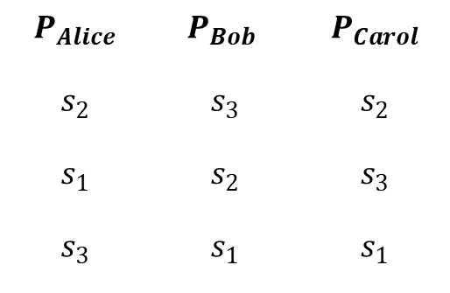
Example 2
Consider 3 students and 3 schools with the following preferences/priorities. Each school has a capacity of 1
$$P_{Alice}$$ | $$P_{Bob}$$ | $$P_{Carol}$$
$$s_{2}$$ | $$s_{3}$$ | $$s_{2}$$
$$s_{1}$$ | $$s_{2}$$ | $$s_{3}$$
$$s_{3}$$ | $$s_{1}$$ | $$s_{1}$$
$${\overline{π}}_{s_{1}}$$ | $${\overline{π}}_{s_{2}}$$ | $${\overline{π}}_{s_{3}}$$
$$Alice$$ | $$Bob$$ | $$Carol$$
$$[Bob, Carol]$$ | $$[Alice, Carol]$$ | $$[Alice, Bob]$$
We cannot run DA (with students proposing) if priorities are weak. To break them up we can do a lottery. Suppose the order was: Alice>Bob>Carol

Slide 13
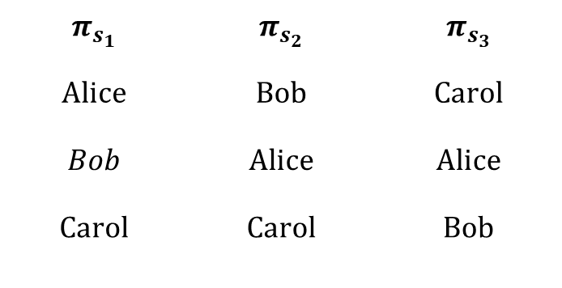
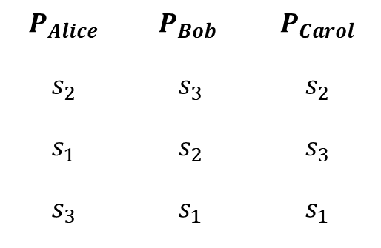
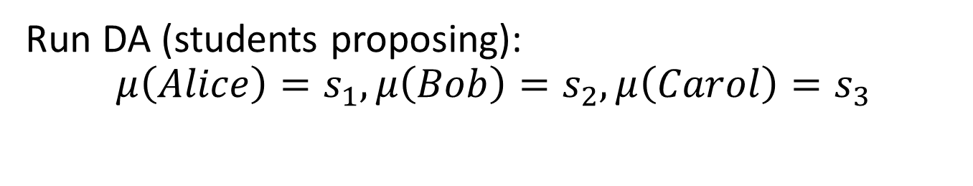
Example 2
Consider 3 students and 3 schools with the following preferences/priorities. Each school has a capacity of 1
$$P_{Alice}$$ | $$P_{Bob}$$ | $$P_{Carol}$$
$$s_{2}$$ | $$s_{3}$$ | $$s_{2}$$
$$s_{1}$$ | $$s_{2}$$ | $$s_{3}$$
$$s_{3}$$ | $$s_{1}$$ | $$s_{1}$$
$$π_{s_{1}}$$ | $$π_{s_{2}}$$ | $$π_{s_{3}}$$
$$Alice$$ | $$Bob$$ | $$Carol$$
$$Bob$$ | $$Alice$$ | $$Alice$$
$$Carol$$ | $$Carol$$ | $$Bob$$
Run DA (students proposing):
$$μ\left(Alice\right)=s_{1},μ\left(Bob\right)=s_{2}, μ\left(Carol\right)=s_{3}$$

Slide 14
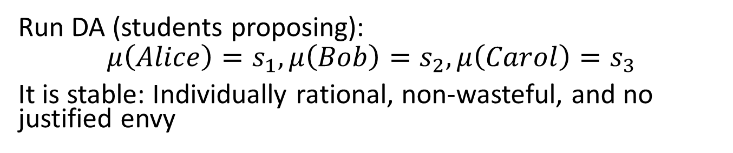
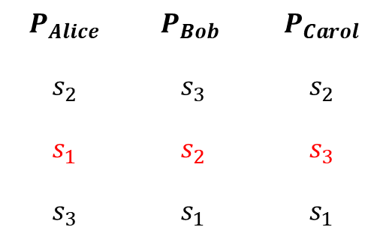
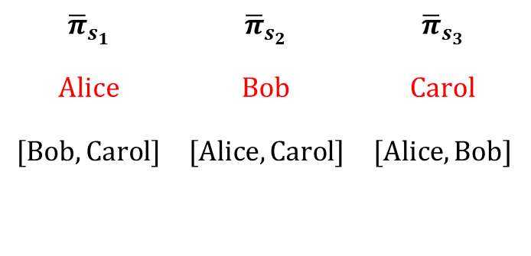
Example 2
Consider 3 students and 3 schools with the following preferences/priorities. Each school has a capacity of 1
$$P_{Alice}$$ | $$P_{Bob}$$ | $$P_{Carol}$$
$$s_{2}$$ | $$s_{3}$$ | $$s_{2}$$
$$s_{1}$$ | $$s_{2}$$ | $$s_{3}$$
$$s_{3}$$ | $$s_{1}$$ | $$s_{1}$$
$${\overline{π}}_{s_{1}}$$ | $${\overline{π}}_{s_{2}}$$ | $${\overline{π}}_{s_{3}}$$
$$Alice$$ | $$Bob$$ | $$Carol$$
$$[Bob, Carol]$$ | $$[Alice, Carol]$$ | $$[Alice, Bob]$$
Run DA (students proposing):
$$μ\left(Alice\right)=s_{1},μ\left(Bob\right)=s_{2}, μ\left(Carol\right)=s_{3}$$
It is stable: Individually rational, non-wasteful, and no justified envy

Slide 15
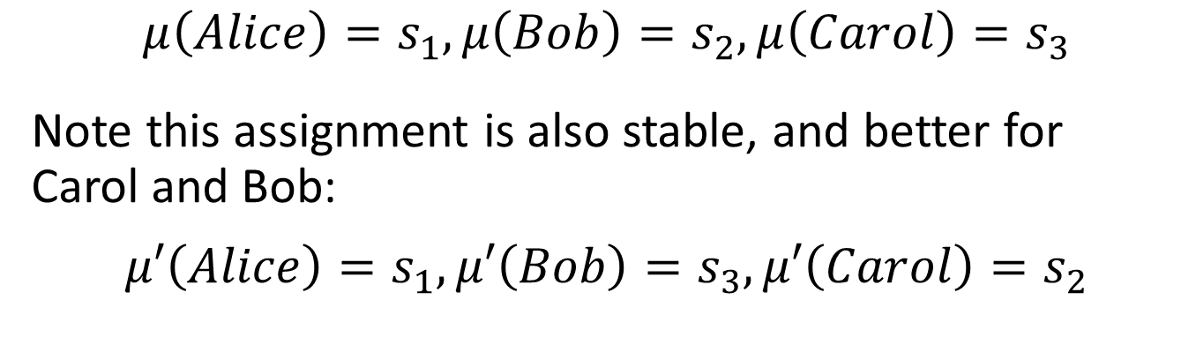
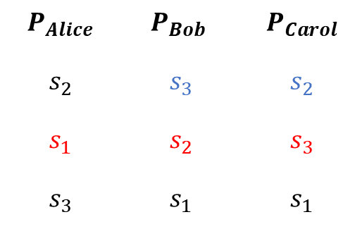
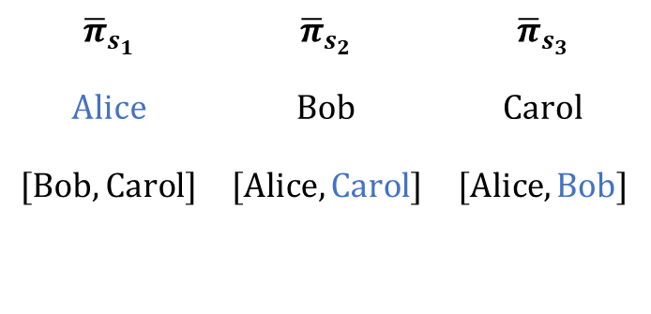
Example 2
$$P_{Alice}$$ | $$P_{Bob}$$ | $$P_{Carol}$$
$$s_{2}$$ | $$s_{3}$$ | $$s_{2}$$
$$s_{1}$$ | $$s_{2}$$ | $$s_{3}$$
$$s_{3}$$ | $$s_{1}$$ | $$s_{1}$$
$${\overline{π}}_{s_{1}}$$ | $${\overline{π}}_{s_{2}}$$ | $${\overline{π}}_{s_{3}}$$
$$Alice$$ | $$Bob$$ | $$Carol$$
$$[Bob, Carol]$$ | $$[Alice, Carol]$$ | $$[Alice, Bob]$$
$$μ\left(Alice\right)=s_{1},μ\left(Bob\right)=s_{2}, μ\left(Carol\right)=s_{3}$$
Note this assignment is also stable, and better for Carol and Bob:
$$μ′\left(Alice\right)=s_{1},μ′\left(Bob\right)=s_{3}, μ′\left(Carol\right)=s_{2}$$

Slide 16
Sources of Inefficiency
We had seen last class that there was a conflict between stability and Pareto efficiency in school matching
Now we area adding that when we have weak preferences, we have an additional source of inefficiency
The inefficiencies created by weak preferences can be solved by letting students trade assignments
We can use an algorithm similar to TTC, but with a modification to pointing rules

Slide 17
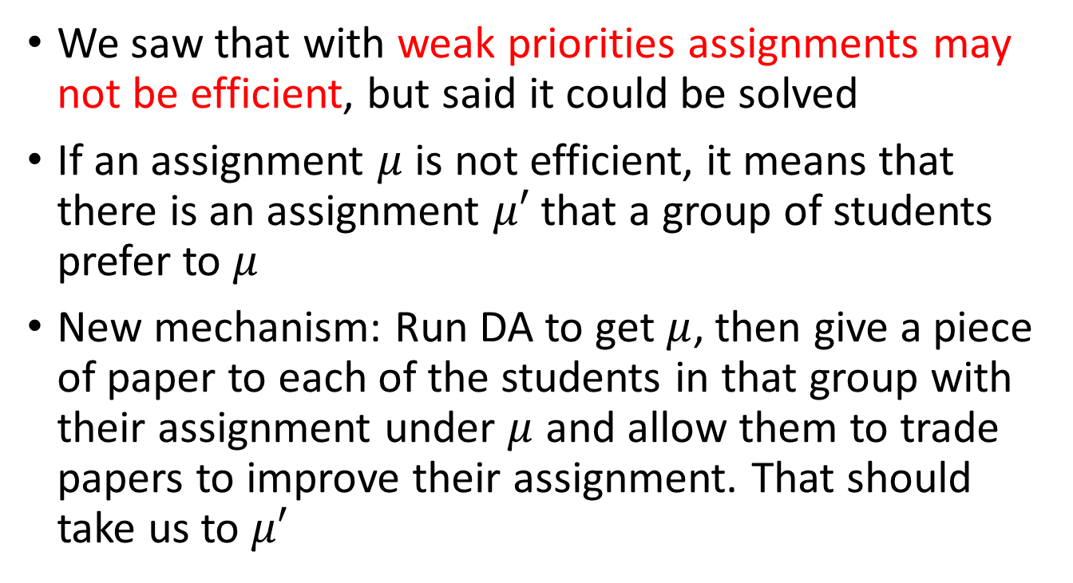
DA + Improvement Cycles
We saw that with weak priorities assignments may not be efficient, but said it could be solved
If an assignment $μ$ is not efficient, it means that there is an assignment $μ′$ that a group of students prefer to $μ$
New mechanism: Run DA to get $μ$, then give a piece of paper to each of the students in that group with their assignment under $μ$ and allow them to trade papers to improve their assignment. That should take us to $μ′$

Slide 18
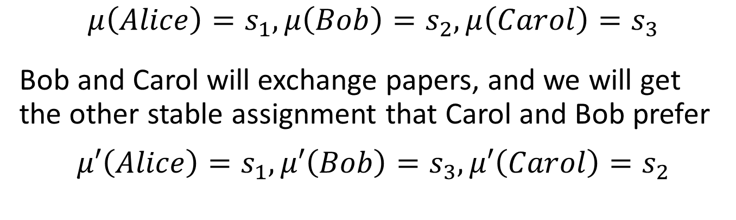
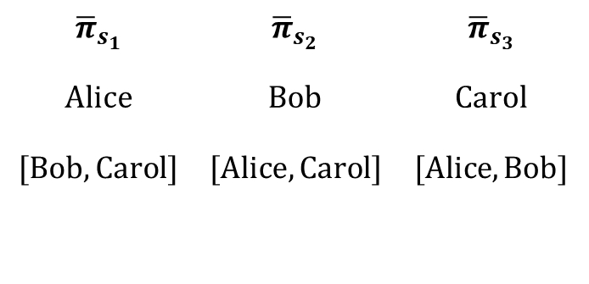
Example 2
$$P_{Alice}$$ | $$P_{Bob}$$ | $$P_{Carol}$$
$$s_{2}$$ | $$s_{3}$$ | $$s_{2}$$
$$s_{1}$$ | $$s_{2}$$ | $$s_{3}$$
$$s_{3}$$ | $$s_{1}$$ | $$s_{1}$$
$${\overline{π}}_{s_{1}}$$ | $${\overline{π}}_{s_{2}}$$ | $${\overline{π}}_{s_{3}}$$
$$Alice$$ | $$Bob$$ | $$Carol$$
$$[Bob, Carol]$$ | $$[Alice, Carol]$$ | $$[Alice, Bob]$$
$$μ\left(Alice\right)=s_{1},μ\left(Bob\right)=s_{2}, μ\left(Carol\right)=s_{3}$$
Bob and Carol will exchange papers, and we will get the other stable assignment that Carol and Bob prefer
$$μ′\left(Alice\right)=s_{1},μ′\left(Bob\right)=s_{3}, μ′\left(Carol\right)=s_{2}$$

Slide 19
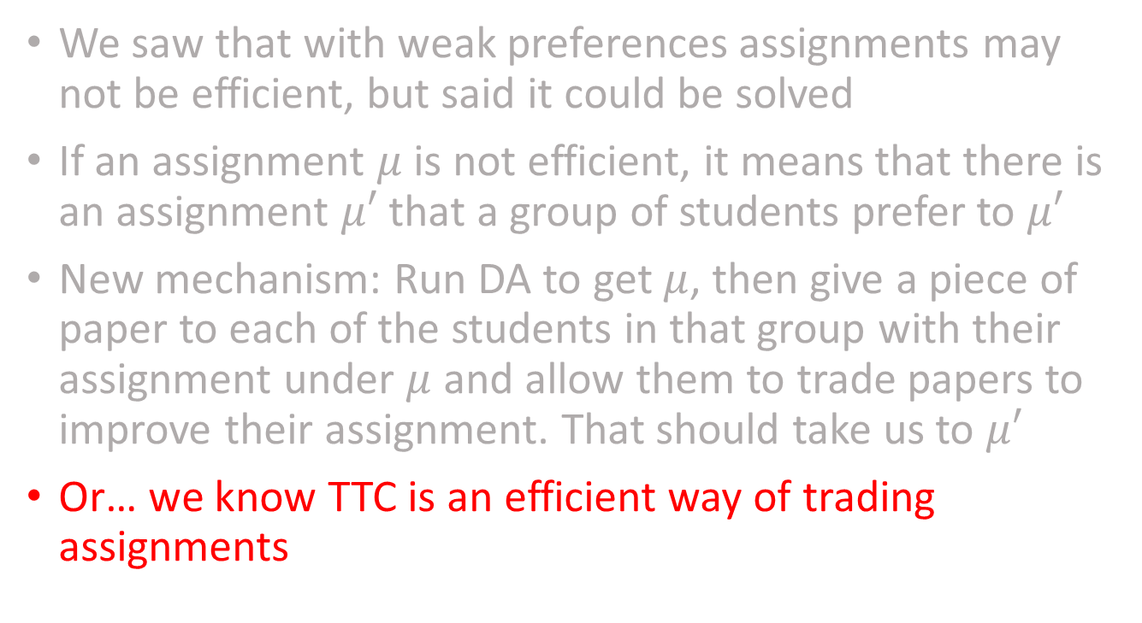
Improvement Cycles
We saw that with weak preferences assignments may not be efficient, but said it could be solved
If an assignment $μ$ is not efficient, it means that there is an assignment $μ′$ that a group of students prefer to $μ′$
New mechanism: Run DA to get $μ$, then give a piece of paper to each of the students in that group with their assignment under $μ$ and allow them to trade papers to improve their assignment. That should take us to $μ′$
Or… we know TTC is an efficient way of trading assignments

Slide 20
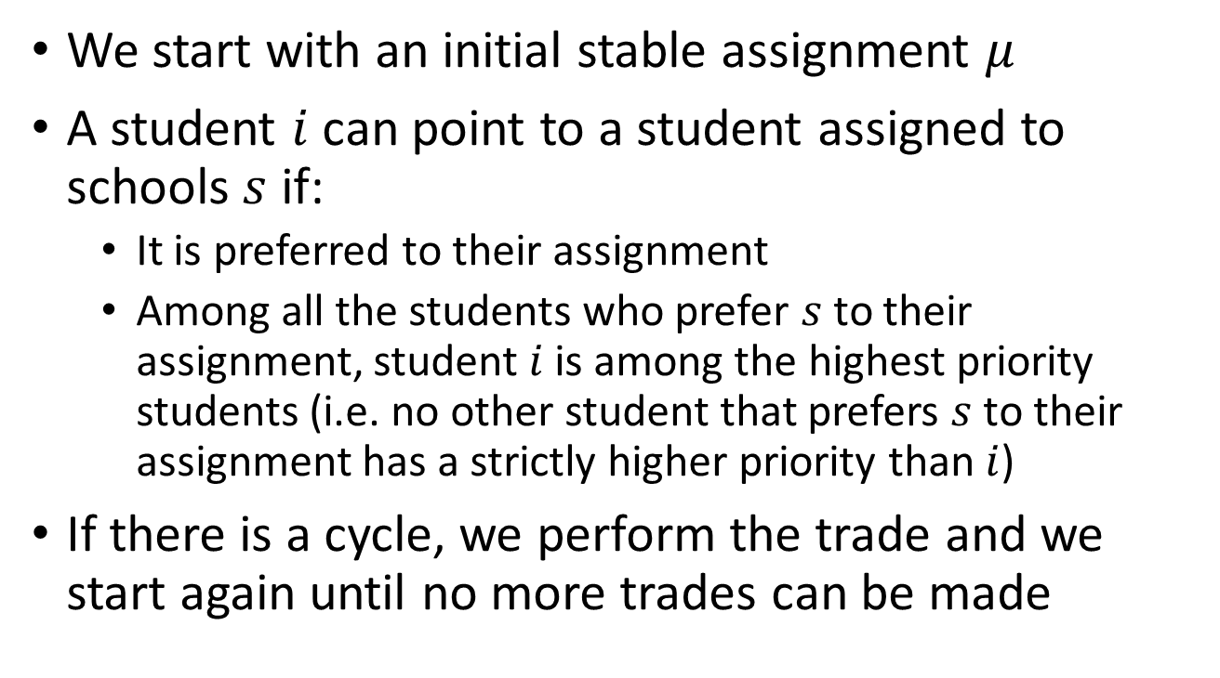
Improvement Cycles
We start with an initial stable assignment $μ$
A student $i$can point to a student assigned to schools $s$ if:
  It is preferred to their assignment
  Among all the students who prefer $s$ to their assignment, student $i$is among the highest priority students (i.e. no other student that prefers $s$to their assignment has a strictly higher priority than $i$)
If there is a cycle, we perform the trade and we start again until no more trades can be made

Slide 21
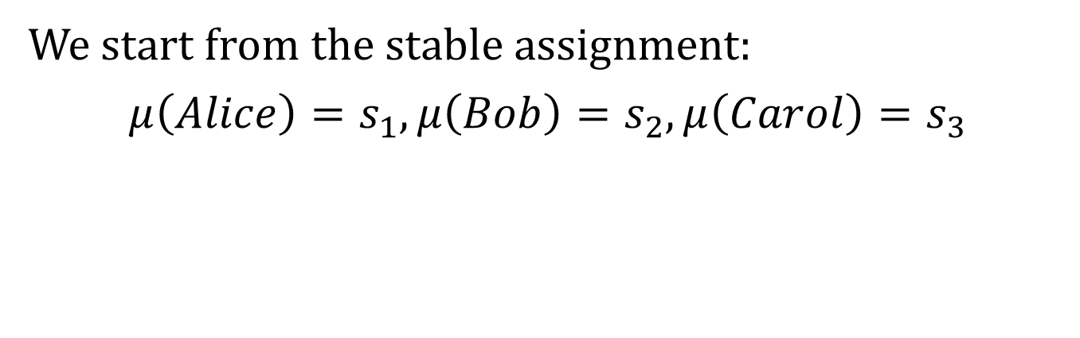
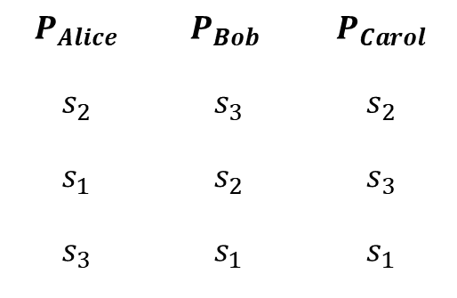
Example 3
$$P_{Alice}$$ | $$P_{Bob}$$ | $$P_{Carol}$$
$$s_{2}$$ | $$s_{3}$$ | $$s_{2}$$
$$s_{1}$$ | $$s_{2}$$ | $$s_{3}$$
$$s_{3}$$ | $$s_{1}$$ | $$s_{1}$$
$${\overline{π}}_{s_{1}}$$ | $${\overline{π}}_{s_{2}}$$ | $${\overline{π}}_{s_{3}}$$
$$Alice$$ | $$Bob$$ | $$Carol$$
$$[Bob, Carol]$$ | $$[Alice, Carol]$$ | $$[Alice, Bob]$$
We start from the stable assignment:
$$μ\left(Alice\right)=s_{1},μ\left(Bob\right)=s_{2}, μ\left(Carol\right)=s_{3}$$

Slide 22


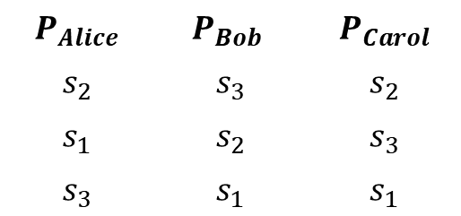

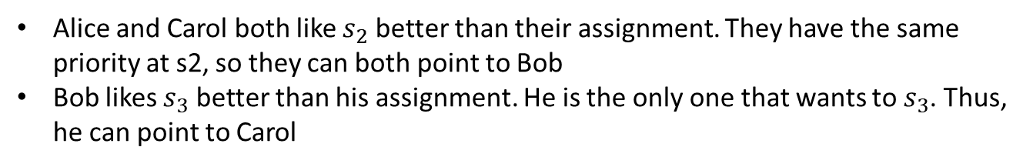
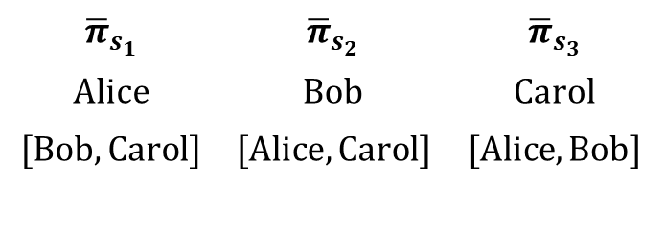
Example 3
$$P_{Alice}$$ | $$P_{Bob}$$ | $$P_{Carol}$$
$$s_{2}$$ | $$s_{3}$$ | $$s_{2}$$
$$s_{1}$$ | $$s_{2}$$ | $$s_{3}$$
$$s_{3}$$ | $$s_{1}$$ | $$s_{1}$$
$${\overline{π}}_{s_{1}}$$ | $${\overline{π}}_{s_{2}}$$ | $${\overline{π}}_{s_{3}}$$
$$Alice$$ | $$Bob$$ | $$Carol$$
$$[Bob, Carol]$$ | $$[Alice, Carol]$$ | $$[Alice, Bob]$$
$$μ\left(Alice\right)=s_{1},μ\left(Bob\right)=s_{2}, μ\left(Carol\right)=s_{3}$$
Alice and Carol both like $s_{2}$ better than their assignment. They have the same priority at s2, so they can both point to Bob
Bob likes $s_{3}$ better than his assignment. He is the only one that wants to $s_{3}$. Thus, he can point to Carol
$$s_{2}$$
Bob
Bob and Carol can trade assignments (and get their top choice)
Only Alice will be left without her top choice thus no more trades are possible
Alice
$$s_{2}$$
$$s_{3}$$
Carol

Slide 23
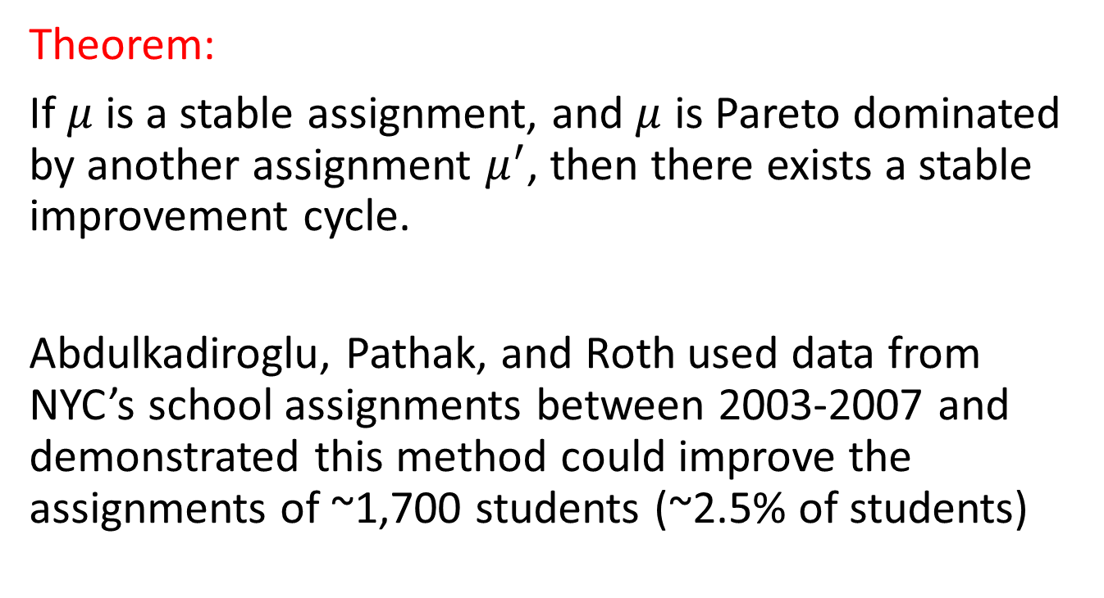
How Frequently does this work?
Theorem:
If $μ$ is a stable assignment, and $μ$ is Pareto dominated by another assignment $μ^{′}$, then there exists a stable improvement cycle.
Abdulkadiroglu, Pathak, and Roth used data from NYC’s school assignments between 2003-2007 and demonstrated this method could improve the assignments of ~1,700 students (~2.5% of students)

Slide 24
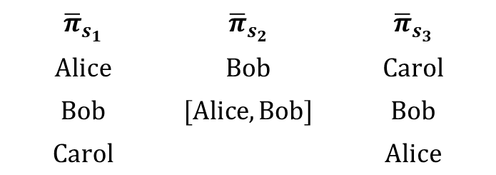
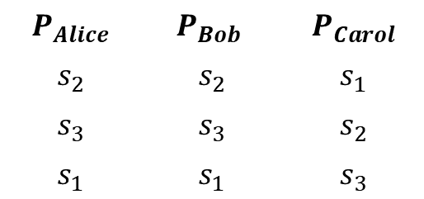
Is it strategyproof?
Improvement cycles help us find stable and efficient matchings. But, is the mechanism strategyproof?
  NO! We cannot have a strategy proof mechanism that selects an efficient assignment when there are weak priorities
Example:
$$P_{Alice}$$ | $$P_{Bob}$$ | $$P_{Carol}$$
$$s_{2}$$ | $$s_{2}$$ | $$s_{1}$$
$$s_{3}$$ | $$s_{3}$$ | $$s_{2}$$
$$s_{1}$$ | $$s_{1}$$ | $$s_{3}$$
$${\overline{π}}_{s_{1}}$$ | $${\overline{π}}_{s_{2}}$$ | $${\overline{π}}_{s_{3}}$$
$$Alice$$ | $$Bob$$ | $$Carol$$
$$Bob$$ | $$[Alice, Bob]$$ | $$Bob$$
$$Carol$$ |  | $$Alice$$

Slide 25
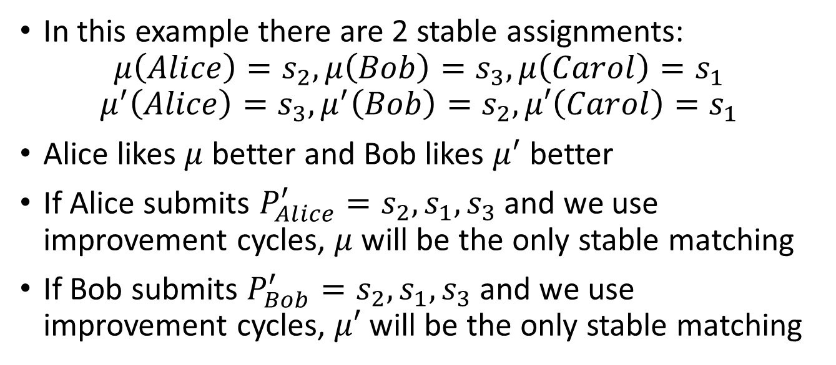
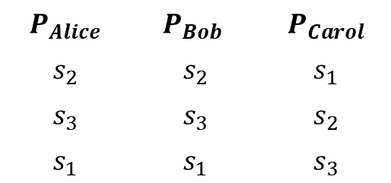
Example 4
$$P_{Alice}$$ | $$P_{Bob}$$ | $$P_{Carol}$$
$$s_{2}$$ | $$s_{2}$$ | $$s_{1}$$
$$s_{3}$$ | $$s_{3}$$ | $$s_{2}$$
$$s_{1}$$ | $$s_{1}$$ | $$s_{3}$$
$${\overline{π}}_{s_{1}}$$ | $${\overline{π}}_{s_{2}}$$ | $${\overline{π}}_{s_{3}}$$
$$Alice$$ | $$Carol$$ | $$Carol$$
$$Bob$$ | $$[Alice, Bob]$$ | $$Bob$$
$$Carol$$ |  | $$Alice$$
In this example there are 2 stable assignments:
$$μ\left(Alice\right)=s_{2},μ\left(Bob\right)=s_{3}, μ\left(Carol\right)=s_{1}$$
$$μ^{′}\left(Alice\right)=s_{3},μ^{′}\left(Bob\right)=s_{2}, μ′\left(Carol\right)=s_{1}$$
Alice likes $μ$ better and Bob likes $μ^{′}$ better
If Alice submits $P_{Alice}^{′}=s_{2}, s_{1},s_{3}$ and we use improvement cycles, $μ$ will be the only stable matching
If Bob submits $P_{Bob}^{′}=s_{2}, s_{1},s_{3}$ and we use improvement cycles, $μ′$ will be the only stable matching

Slide 26
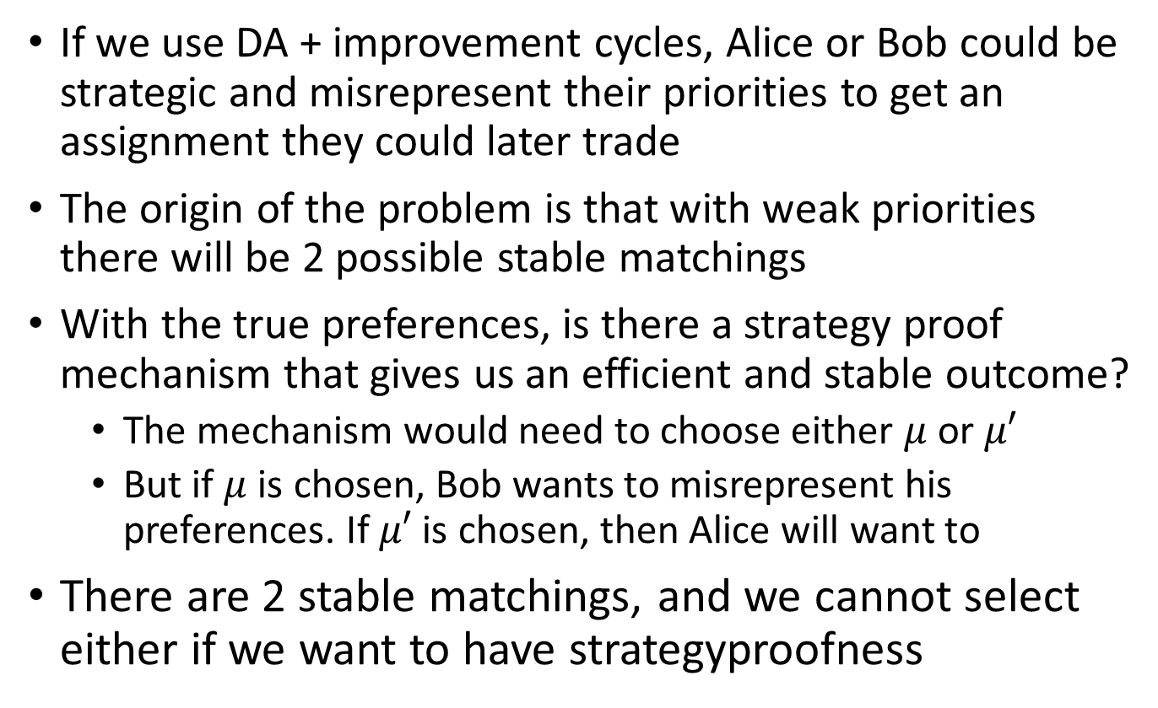
Understanding Example 4
If we use DA + improvement cycles, Alice or Bob could be strategic and misrepresent their priorities to get an assignment they could later trade
The origin of the problem is that with weak priorities there will be 2 possible stable matchings
With the true preferences, is there a strategy proof mechanism that gives us an efficient and stable outcome?
  The mechanism would need to choose either $μ$ or $μ′$
  But if $μ$ is chosen, Bob wants to misrepresent his preferences. If $μ′$ is chosen, then Alice will want to
There are 2 stable matchings, and we cannot select either if we want to have strategyproofness

Slide 27
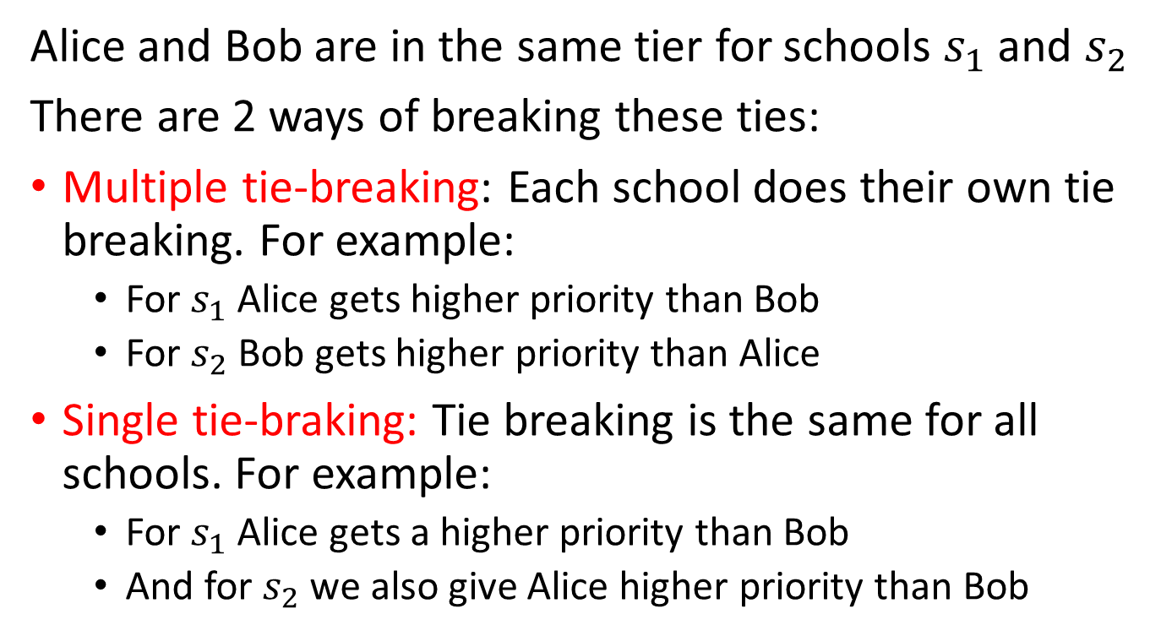
Tie Breaking
Alice and Bob are in the same tier for schools $s_{1}$ and $s_{2}$
There are 2 ways of breaking these ties:
Multiple tie-breaking: Each school does their own tie breaking. For example:
  For $s_{1}$ Alice gets higher priority than Bob
  For $s_{2}$ Bob gets higher priority than Alice
Single tie-braking: Tie breaking is the same for all schools. For example:
  For $s_{1}$ Alice gets a higher priority than Bob
  And for $s_{2}$ we also give Alice higher priority than Bob

Slide 28
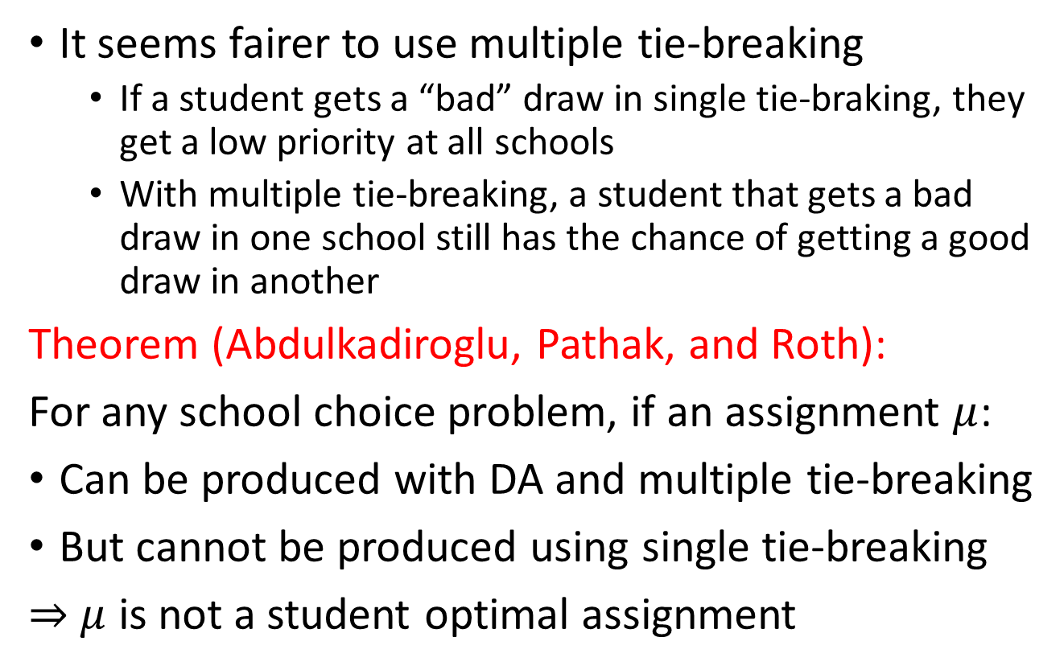
Which one is better?
It seems fairer to use multiple tie-breaking
  If a student gets a “bad” draw in single tie-braking, they get a low priority at all schools
  With multiple tie-breaking, a student that gets a bad draw in one school still has the chance of getting a good draw in another
Theorem (Abdulkadiroglu, Pathak, and Roth):
For any school choice problem, if an assignment $μ$:
Can be produced with DA and multiple tie-breaking
But cannot be produced using single tie-breaking
$⇒$ $μ$ is not a student optimal assignment

Slide 29
Single vs Multiple Tie Breaking
The previous theorem seems counter-intuitive
What do we lose if we don’t use multiple tie-breaking:
  We will have a lot fewer possible assignments (as there are fewer possible priority orderings)
  But it happens that we don’t loose much, because if you cannot replicate those matching with a single tie breaking rule, they were not good matchings
Abdulkadiroglu, Pathak and Roth (2009) used data from the NYC 2006-2007 matching to run 250 simulations and prove this point to NYC authorities when they helped re-designed their algorithm

Slide 30
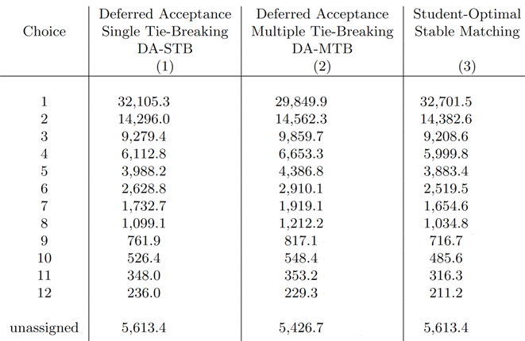
Comparing Rules
Source: https://www.nber.org/papers/w14864
Note: 3 is created by using DA-STB followed by improvement cycles
Notes:
DA-STB is very close to student optimal stbale matching. While in theory, there will always be improvements cycles, that is a result that hold for any priority ordering. In real life, with real priorities, improvement cycles are not needed much.

Slide 31
Comparing Rules
Source: https://www.nber.org/papers/w14864
Note: 3 is created by using DA-STB followed by improvement cycles
Notes:
DA-STB is very close to student optimal stbale matching. While in theory, there will always be improvements cycles, that is a result that hold for any priority ordering. In real life, with real priorities, improvement cycles are not needed much.

Slide 32
Comparing Rules
Source: https://www.nber.org/papers/w14864
Note: 3 is created by using DA-STB followed by improvement cycles
Notes:
DA-STB is very close to student optimal stbale matching. While in theory, there will always be improvements cycles, that is a result that hold for any priority ordering. In real life, with real priorities, improvement cycles are not needed much.

Slide 33
Constraining Choices
In real life matching markets, there are often many participants:
  Medical match has 30k+ participants
  NYC High School match, 90k+ students, 500+ programs
It is usual to constraint the number of options that participants can rank
  In NYC high school, students can only rank 12 programs
Partly historical: In the past matches were manual
Partly behavioral:
  Impossible to rank 500 programs
  Force participants to think hard which programs they prefer, and not list programs they would not consider

Slide 34
Effects of Constraining Choices
If choice is constrained, it is impossible to have a strategy proof mechanism. However, not all is lost:
Theorem
If students can only list k programs in their preferences, and we use DA or TTC:
If students find k or less programs acceptable, the they can do no better than submitting true preferences
If a students finds more than k programs acceptable, they can do no better than selecting k programs among those acceptable, and rank those according to their true preferences.

Slide 35
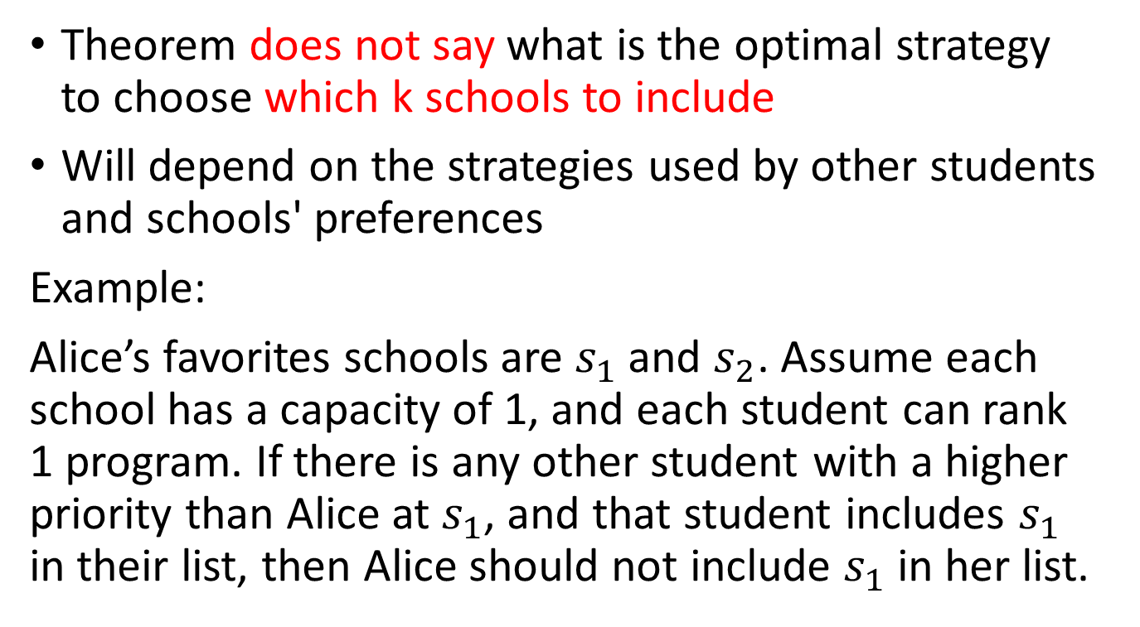
Which k programs to include?
Theorem does not say what is the optimal strategy to choose which k schools to include
Will depend on the strategies used by other students and schools' preferences
Example:
Alice’s favorites schools are $s_{1}$ and $s_{2}$. Assume each school has a capacity of 1, and each student can rank 1 program. If there is any other student with a higher priority than Alice at $s_{1}$, and that student includes $s_{1}$ in their list, then Alice should not include $s_{1}$ in her list.

Slide 36
Effects of Constraining Choices
The real-life effects of constraining choices is hard to determine with empirical data
  You know what people did in the constrained setup, you don’t know their true preferences
Alternative is to do experiments simulating constrained and unconstrained situations
Calsamiglia and Klijn did such an experiment:
  Participants were given a list of schools. Each had an associated payoff. Then they asked participants to rank the schools telling them they would be paid according to the school they were assigned to (simulating different setups)
Results show constraining choices produces worst outcomes

Slide 37
Do parents make informed choices?
Hastings and Weinsten (2008) did an experiment in Charlotte, SC
  Base case: Information (schools’ test scores) is available, but hot highlighted
  In the base case, low income familied tended to choose their local school
  In information is highlighted, low income families are more likely to choose a high performing school
Part of mechanism design is helping people understand the mechanism and giving them useful information so they can make good decisions

Slide 38
Theory vs Practice
We have discussed different ways of dealing with the school choice problem and its difficulties
Given the nature of the problem, we saw it is impossible to have a perfect mechanism (strategy proof, efficient, and stable)
Practice in school choice has been to move from very bad mechanisms, to better (but not perfect) mechanisms
The decision of which mechanisms to use is social/political

Slide 39
Boston Program
Abdulkadiroglu et al (2005) helped redesign the system
The immediate acceptance algorithm Boston was using was bad
  They found 19% listed two over demanded schools as top two choices and about a quarter ended up unassigned
They suggested DA with students proposing or TTA
Officials chose DA with students proposing because they didn’t like the idea of “trading priorities”

Slide 40
NYC Program
Initially a decentralized system, with 90k students that could submit up to 5 applications
  Each school made offers on their own and kept a waiting list
  Students accept or rejects offers. Then schools made 3 rounds of offers to waiting list
Roughly 30k students were unassigned and had to be matched administratively
Unlike Boston schools do have preferences and were often strategic

Slide 41
NYC Program reformed
NYC now uses student-proposing DA:
  Students can rank up to 12 schools
  Some schools get filled first using examinations
  Some top students automatically get their first choice
  Unmatched students go to second round that uses random serial dictatorship
First year of the new system:
  More than 70k got one of their choice schools
  Another 7600 got a school in second round
  Only 3k unassigned (down from 30k) students had to be manually matched

Slide 42
School Choice Take Away
School choice is a recent application of matching theory. Many school districts have been doing changes in the last 10-15 years
It is a many-to-one assignment problem, with some differences:
  Schools (most often) don’t have preferences over students
  School have priorities over students and must rank everyone
  Students may find schools unacceptable

Slide 43
School Choice Take Away
We defined stability in the school choice as:
  Individual rationality
  Non wastefulness
  No justified envy
We defined efficiency in school choice based on Pareto efficiency considering only students’ preferences
In general, stability and efficiency are not compatible in the school choice problem
  Even when they can both be achieved, there is not strategy proof mechanism that would give you that matching

Slide 44
School Choice Take Away
Immediate acceptance was used by Boston Public Schools (and many others), but was not strategy proof
  Policy makers like to boast that with IA most students are matched to their top choice (but that is a lie)
Deferred acceptance (students propose) and top trading cycles can be used and are strategy proof
  They typically won’t give the same assignment
  If you want efficiency, use TTC
  If you want stability, use DA

Slide 45
School Choice Take Away
Schools’ priorities are weak. We cannot really use DA and TTC with weak priorities, so we break ties randomizing
This introduces an additional source of inefficiencies
  But that can be solved with improvement cycles
We could break ties with single or multiple tie breaking
  While multiple tie braking “seems” fairer, single is better
Also, important to consider how people will behave:
  Do they understand the mechanism and have enough info?

